Slide 1
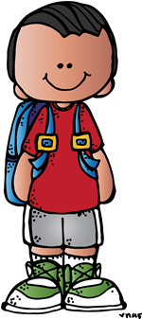

Welcome to
Back to School Night
Kindergarten
2019-2020
Mrs. Chen, Mrs. Linder,
Ms. Ormand, Mrs. Purdy
This whole presentation
is on our kinder home page.
Notes:
Cody – welcome

Slide 2
E.E.F.
Eanes Education Foundation
(Click above to go to video)
https://vimeo.com/radarcreativestudio/review/354646803/f7bb2601a1
Notes:
Purdy invite them up.

Slide 3


FTE Booster Club
To Do:
1. Sign up on the website: foresttrailbc.membershiptoolkit.com
-Popcorn
-Directory
-Birthday Messages
-No Hassle Fundraiser
2. Follow us on Social Media
-Instagram: @fteboosterclub
-Facebook: facebook.com/FTEBC
3. Volunteer sign-ups tomorrow at Muffin Morning
Save these Dates:
-First Booster Club Meeting-BC 101: Friday, September 6th (Library)
-Falcon Frolics: Friday, September 27th
-BINGO Night: Saturday, September 28th
-Kindergarten Parent Social: Saturday, October 26th
-Forest Trail School-Wide Auction Party: Saturday, February 8th
Notes:
Purdy invite them up

Slide 4
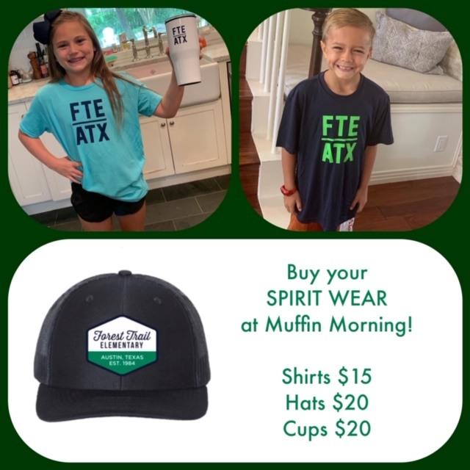
FTE Booster Club
Cash or check only

Slide 5

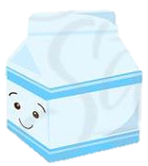

Muffin Morning
7:30-8:30a.m. on Tuesday the 21st
An important time for your child to meet their teacher.
It is a come and go event.
Take a picture of your child with his/her teacher.
First day of school drop off at the “hug zone”.
Notes:
Karen Purdy:
Muffin Morning:
This is an important time for your child to meet their teacher and get familiar with with some classmates and their classroom.
It is a come and go event where kids will need to bring their school supplies (if they did not order them through the booster club fundraiser) and divide them up.
If they ordered them through booster club – the packets will be already in the classroom.
This helps them feel comfortable exploring the room.
Muffin morning is the time to take a picture of your child with their kindergarten teacher. First day of school they are encouraged to be dropped off at the “hug zone”.

Slide 6

Kinder Schedule
7:45
Earliest kids can be dropped off in cafeteria
Classrooms open
8:10
8:20
School starts
8:20
Academics
10:30
Brain Break
10:50
Lunch
11:15
Academics
Notes:
Karen Purdy
Kinder schedule:
Please don’t be tardy, say goodbye at entry, no walking to class- it’s harder on the kids- promise!

Slide 7

Our Daily Schedule Cont…
12:35
Specials
1:25
Recess
1:55
Snack and Story Time
2:15
Academics
S.T.E.A.M. / Developmental Centers
2:45
Closure and Pack Up
3:15
Dismissal
3:30
Notes:
Karen Purdy
This is a flexible schedule and can change based on assemblies and special presentations and learning experiences that pop up, etc…

Slide 8





Specials…
Art, Music and P.E. are on a 3 day rotation.
Find your child’s specials schedule on teacher’s webpage.
FTE home page has calendar that lists
A day, B day or C day.
Tennis shoes are preferred footwear.
Privacy shorts needed under skirts and dresses.
Notes:
Karen Purdy
Specials:
Art, Music and P.E. are on a 3 day rotation schedule.
You will find your child’s specials schedule on your teacher’s webpage.
They will list their A day, B day and C day specials assignment.
The Forest Trail home page has a calendar that lists each school day is an A day, B day or C day.
The P.E. and Music teacher require students to wear tennis shoes.
Tennis shoes are the preferred footwear for school. Historically - if kids don’t have on sneakers – they may miss PE activities.

Slide 9

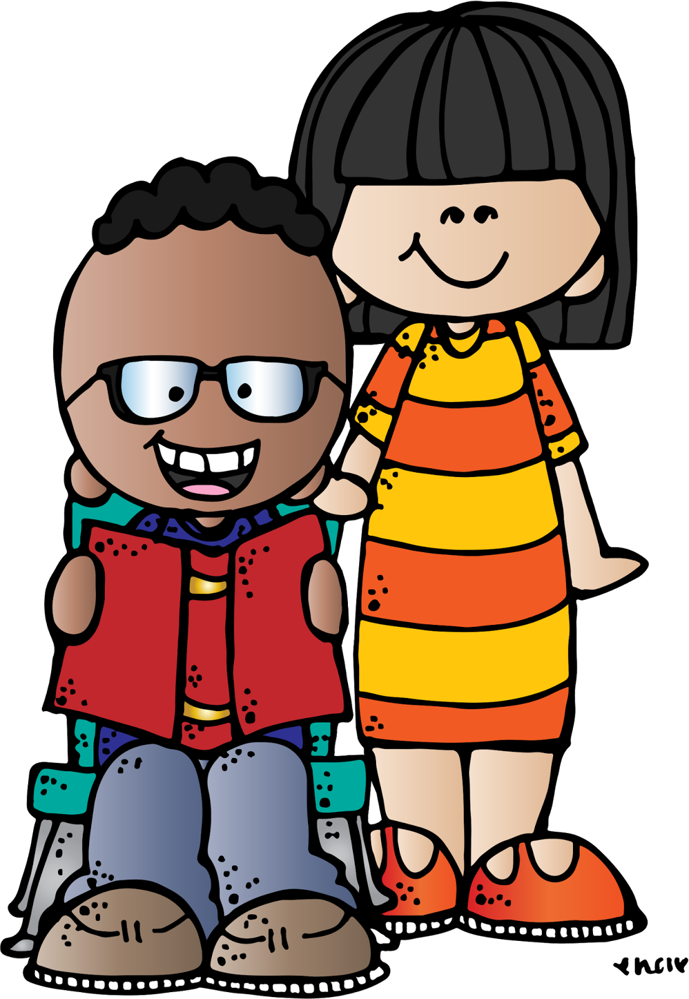
For the 1st day …
The RIGHT sized backpack.
Labeled water bottle
(Can be filled at school)
Lunch or lunch money in account. (Encouraged to bring lunch first 3 days).
Healthy snack. (Water only for snack).
Full set of extra clothes in labeled bag.
Headphones sent in on the first week.
What NOT to have: toys, trinkets, distractions, etc...
Notes:
Karen Purdy:
1st day must haves:
Backpack: a non-rolling, appropriately-sized and
able to hold – (Ormand will hold up a good backpack example)
bringing lunch only because the first three days it takes a long time for them to go through the line, but we practice how to do it the first three days.
It needs to be able to hold…a binder, library books, jacket, lunchbox, water bottle, and snack, etc...
Water bottle: labeled with name, non spill, can send it empty can kids can fill it up at school. (show good size). (Ormand will hold up a good water bottle example)
Lunch or lunch money in their account if buying lunches, please put in money in their account before the first day or online.
Snack – healthy. More about snacks to come…
Full set of extra clothes in gallon zip lock bag labeled with name.
Send in kid-friendly headphones labeled with name and sent in sometime during the first week. More about headphones.
What NOT to have:
toys, devices, trinkets, any distracting items.

Slide 10


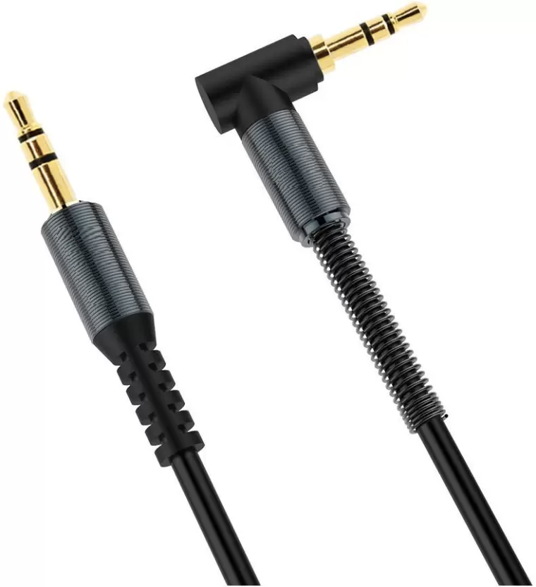


Headphones…
Recommended headphones: Non-ear bud style, with straight headphone jack.
Label the headphones.
Notes:
Karen Purdy
Headphones: The kids chew and twist these despite our reminders not to and therefore they will likely be sent home with nonworking headphones and need a replacement pair. Good idea to buy two.
Kindergarteners use these headphones and chew on them. They will probably require replacement headphones during the year.

Slide 11


Academics…
Link on webpage to T.E.K.S.
Language Arts: Fountas and Pinnell
Phonics: Fountas and Pinnell
Lucy Calkins Writer’s Workshop
Handwriting Without Tears
Math: Envisions
Science: FOSS
S.T.E.A.M Carts
Social Studies: Texas Studies Weekly
Social Emotional Learning:
Second Step /Social Thinking
Notes:
Karen Linder:
Academics:
Link on webpage to Texas Essential Knowledge and Skills.
Language Arts curriculum: Fountas and Pinnell IRA, Mini lessons, and word study phonics
Handwriting: handwriting without tears
Writing curriculum: Lucy Calkins Writer’s Workshop
Social Studies curriculum: Studies Weekly
S.E.L. curriculum: Social Thinking/ Second Step
Science curriculum: FOSS
Math curriculum: Envisions

Slide 12
Volunteering…
Many opportunities. Please sign up to volunteer on sign up.com with Booster Club.
More specifics given later in your child’s room.
“Creation Station” on Fridays at 11:15.
If separation issues - please wait till later on to volunteer.
Notes:
Susan:
Volunteering:
There are many opportunities to get involved with your child’s class and school.
More specific instructions will be given in your child’s room later.
As a grade level we all participate in weekly in class art time called “Creation Station”. This is held on Fridays at 11:15.
HOW TO volunteer – you’ll receive directions receive in classroom.
Discuss with your child that if they have a hard time transitioning when you leave that you may not be able to volunteer often if they are too upset. This can effect their learning afterwards and others.
If your child has separation issues and becomes distressed please wait till later in the year to volunteer.

Slide 13



Lunch…
No reheated items, no microwaving.
Easily-opened products.
Healthy lunches please.
No glass.
Please NO lunch visitors for 2 weeks.
Separate and label lunch and snack.
Notes:
Susan:
At lunch time there will be a limited number of staff helping. For this reason we ask that kids not bring lunches that need reheating.
Foster independence in your child by sending easily-opened products and containers. Keep in mind that behavior is often effected when kids have too much sugar. Healthy lunches keep them focused. Do not send any glass containers.
Please NO lunch visitors for 2 weeks. Visitors early-on often make the transition more difficult for the child and increase anxiety when parent leaves after lunch.
Separate and label lunch and snacks for a few weeks. (Kids often get confused and eat both at lunch.)

Slide 14

Snacks…
SNACK
Water ONLY for snack time.
Juices or sticky drinks are lunchroom only.
No sugary snacks.
No messy snacks that need spoons.
Staff/peers not allowed to provide snacks.
Try to pack extra snack in backpack just in case. See teacher for specifics.
Notes:
Susan:
Water only for snack time.
Juices or sticky drinks are lunchroom only.
No sugary snacks.
No messy snacks that need spoons.
State law prohibits staff from providing snacks or kid sharing snacks at school.
Try to pack an extra snack in their backpack.

Slide 15
Tidbits…
Library
Popcorn Days
& changes
Class T-shirts
Notes:
Susan Ormand:
Soon your child will be visiting Mrs. Tillman in the Library. They will get to check out books to read with family. Please remind your child when library day is near to return their book – this is a good way to help them learn responsibility.
A note will be going home soon with information about ordering class t-shirts. These will be worn by the whole class on spirit assembly days, field trips and special days. Check the FTE homepage to see when spirit assemblies will be held.
The booster club sells popcorn for many Thursdays as a fundraiser.
FYI: At the beginning some parents assume their child won’t want the popcorn for snack but when the kids see others getting it – they all seem to want it too.

Slide 16


Homework…
No homework other than nightly reading.
For absent / make up work: Use electronic resources: IXL, Epic, Reading A-Z, and have them journal on the days they miss about what they did.
Notes:
Sarah Chen
Homework:
School policy: no homework other than nightly reading.
10 minute minimum each night.
However, if your child needs extra help to master a skill they will be sent home with extra practice.

Slide 17
Smart tags…
Smart Tag system…
Will be used for transportation. Must be attached to
child’s backpack before first day of school. If lost, a replacement
must be purchased from the front office.
Notes:
Sarah Chen:
Tell a little about smart tags and need to send it back each and every day.

Slide 18


Transportation Home:
Set up an account for your child on SMART TAG Dismissal manager this evening if you have not already!
At Muffin Morning someone will be here to assist parents in setting up transportation and getting their bus info.
All changes to afternoon transportation must be made before 2:00pm. in SMART TAG Dismissal Manager. (After school programs, birthday parties, etc…)
STAFF IS LEGALLY BOUND TO SEND CHILDREN via the route listed on their SMART TAG Dismissal.
Notes:
Sarah Chen:
First week transportation form must be filled out tonight or handed in on muffin morning.
Changes to transportation PM bus only. Legally required to send them home the way listed as their transportation if no note or phone call is received.
leave transportation tag on backpack.
Bus finder can be found on skyward family access:
If you have not already found out your child’s animal bus name please do so tonight and add this information to your child’s skyward account

Slide 19


Philanthropy…
Last year the students raised money to hatch 25 more chicks for the Community First chicken coop.
This year we will be hatching around 25 more to supplement the Community First flock. Over the years the kids have donated
203 laying hens!
Many opportunities through out the year to foster a giving heart.
Notes:
Chen:
Philanthropy:
opportunities throughout the year.
The Community First Village is a 27 acre community that provides affordable sustainable housing and a supportive community for the disabled, chronically homeless in Central Texas.
We hope to get the kids involved in giving because we know how much philanthropy benefits the giver as well as the receiver.
Why teach philanthropy?
According to developmental psychologist Marilyn Mitchell: “Children who perform acts of kindness experience increased wellbeing. This, in turn, leads to better behavior, social skills and higher academic achievement. They learn about worlds beyond their own experience and develop a broader world-view. This is the beginning of developing empathy and tolerance for others. They learn, just by small acts of giving, how to become a change maker, what it means to be a good-citizen as well as learning from and teaching others how to collaborate and make a difference.”
The whole school has joined with Community First,( a homeless housing center) to provide a great opportunity for kids to get involved in serving their community. This helped kids broaden their world view and learn about philanthropy. We worked in our philanthropy project with our math, science and social/ emotional curriculum.
We helped Community First establish their chicken coop by raising funds, purchasing

Slide 20
Ipads & tech…
The district’s LEAP initiative in kindergarten:
*Learning iPad use skills
*Learning internet safety
*Use district sanctioned apps
*Productive not consumptive apps
*Used for some assessments
*Learning keyboarding
*Learning beginning coding
*Link on our Parent page!
*Commonsense.org
*AAP – screen time… excess re-wires the brain
Notes:
Chen:
parental controls and safeguards…
I need to add stuff from chris millerhere**************************
all screens

Slide 21
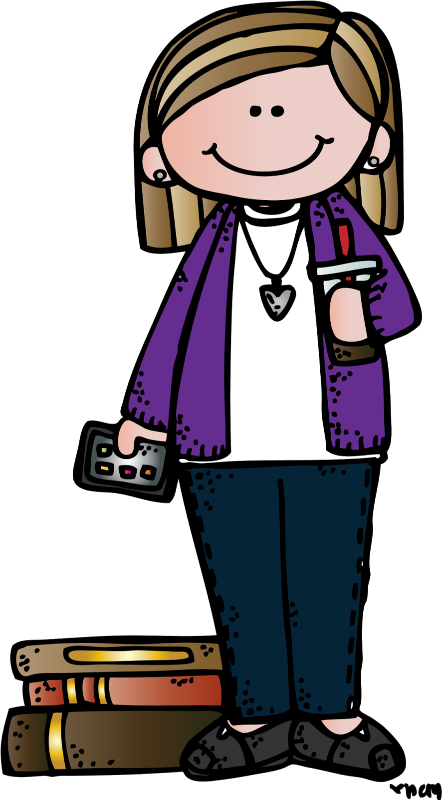


Communication…
We VALUE good communication with parents!
Weekly Newsletters. PLEASE READ THESE.
Report cards are printed for 1st quarter conferences, after that they are to be viewed online.
Phone numbers and email addresses on webpages.
Take Home Binders are to be sent each day.
We can rarely check email during the school day.
Class Bloomz accounts to be joined tonight.
Notes:
Karen Purdy:
Communication:
We VALUE communication with parents! We want to keep you up-to-date and answer questions or concerns you may have. Here are some ways to stay in touch…
We will send out Weekly Newsletters. PLEASE READ THESE.
Our phone numbers and email addresses are on our webpages. Sarah Culpepper recently became Sarah Chen and will have a different email for a while.
Take Home Folders are sent to and from school each day. These carry work, assignments, forms, checks, notes etc… This and library books are your child’s ‘big kid’ responsibilities.
Being a kindergarten teacher means email can not usually be checked during the school day. We can check our email either before or after school. If you have an urgent matter to discuss, please call the school.

Slide 22
Do you have any grade-wide questions for us?
Specific questions can be asked in a moment in your child’s classroom. We will each dismiss to your child’s classroom to learn more about your child’s class and volunteer needs.
Ormand: room 34 Chen: room 33
Linder: room 32 Purdy : room 31
Notes:
Karen Purdy:
If you have any questions about what we have just covered - general grade-level questions please ask. If you have specific questions you can ask those in a moment when we visit your child’s room.

